Slide 1
Biomethane from municipal organic waste as fuel for waste-collecting vehicles
Wilhelm Winkelmann, Berliner Stadtreinigung
01/24/2022

Slide 2
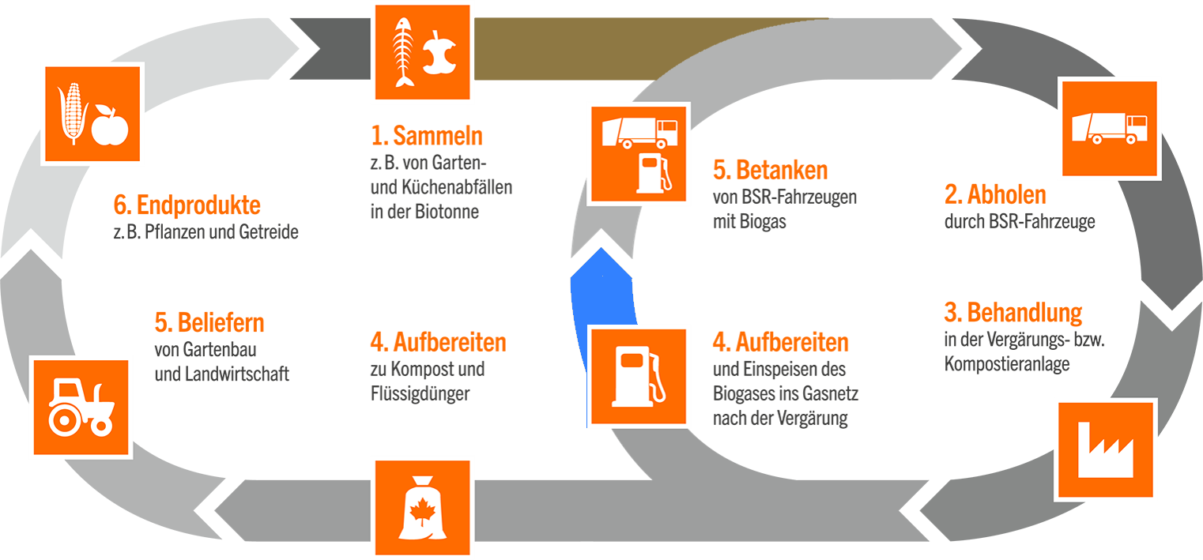
Fermentation of organic waste: Additional benefit from linked cycles
1. Disposal
of organic waste
(waste bins)
6. Agricultural
products
e.g. plants, corn
5. Refueling
BSR vehicle fleet
2. Collecting
of organic waste
(waste bins)
5. Delivery
gardening &
landscaping
companies;
agriculture
3. Waste treatment
processing and
fermentation
4. Preparation
of digestate
(compost, liquid fertilizer)
4. Preparation
of biogas and
feeding into
natural gas grid

Slide 3
Development of organic waste in Berlin Berlin without Brandenburg
Organic
matter
Fallen leaves (loose + in bags)
Tree & shrub brashings
Christmas trees

Slide 4
Organic waste - Ways of treatment
Organic Waste
 | - hardly fermentable - |  | - fermentable -
 | non-compostable | compostable
 | wood fallen leaves | organic waste tree- and shrub brashings fallen leaves | organic waste leftovers e.g. canteen
recycling | incineration | composting | fermentation

Slide 5
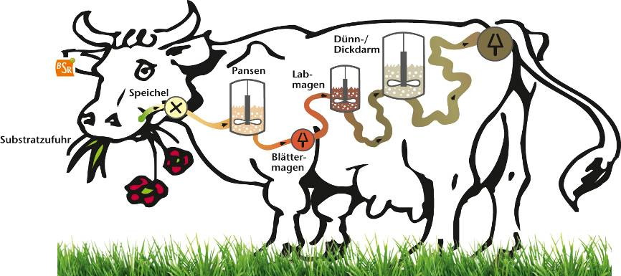
Concept of organic waste fermentation
hydrolysis
propionic acid
acetic acid
methane+CO₂
digestate
- liquid
- solid
small/large intestine
rumen
abomasum
saliva
substrate intake
omasum
organic matter

Slide 6
Possibilities of using biogas
standard | filling into public – natural gas grid |  | biofuel | biogas pipeline (micro gas grid)
biogenous fermentable waste
production of biogas
 | biogas-processing |  |  | biogas pipeline
 | biomethane into grid |  | biomethane filling station
combined heat and power (CHP) electricity heat | withdrawal from grid |  | biogas vehicle fleet | combined heat and power (CHP) electricity heat
 | other consumers | BSR methane filling stations
 |  | BSR vehicle fleet

Slide 7
Key figures 2021
Input: 75,000 Mg/a organic waste from households
Area: 2.7 ha
Employees: 16
Exhaust air: 40,000 m³/h
Production of raw biogas: 103 m³/Mg Input with $∅$ 56% CH₄
Annual production of raw biogas: ~ 6 Mio. m³/a
Production of biomethane: ~ 3 Mio. m³/a
Net production of energy: ~ 31 Mio. kWh/a
Substitution of diesel fuel: ~ 2,5 Mio. liters/a
Output solid aerated fermentation residue: 20,000 Mg/a (c-sequestration, compost)
Output liquid digestate : 40,000 Mg/a (liquid fertilizer)
CO₂-reduction potential: ~ 13,800 Mg CO₂/a from substitution of fuel and c-sequestration
or 185 kg CO₂/Mg Input

Slide 8
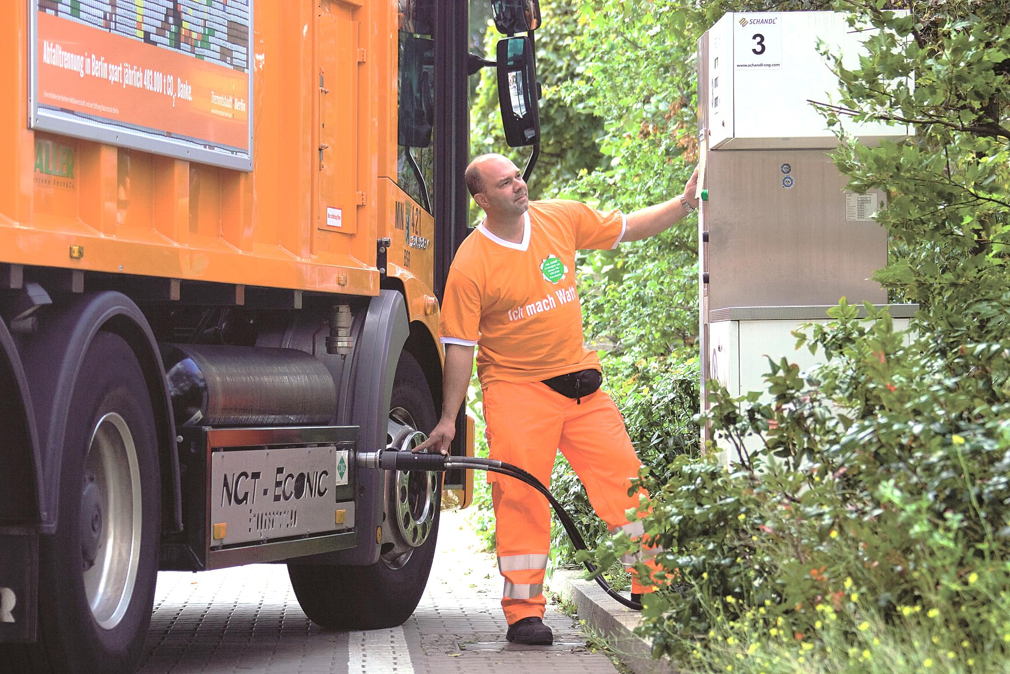
Biomethane used as fuel
3 high-performance gas stations for our
vehicle fleet
165 waste collection vehicles run on
biomethane
(= 50 % of waste collecting vehicle fleet)
467,000 Mg waste* from
1.97 Mio. private households** of the city of Berlin are being collected and transported per year …
with no negative effect on our climate
* residual waste, organic waste (brown bin); ** www.destatis.de, survey 2020

Slide 9
From waste to value

Slide 10
Proceeds from recycling provide a significant contribution to securing steady fees
Steam:
(incinearation plant Ruhleben)
2.3%
Biomethane:
(fermentation plant for organic waste)
0.5%
Scrap metal (FE and NF):
(incinearation plant Ruhleben, treatment of bulky waste, recycling centers)
2.1%
Reduction
of fees
6.0%
Paper:
(recycling centers)
0.5%
Wood:
(treatment of bulky waste, recycling centers)
0.2%
Other:
(e.g. old clothes, recyclables)
0.4%
status: 2020

Slide 11
Biogas plant in Berlin: Sources of proceeds
price development
Using the natural gas grid allows:
Delivery of gas to our fleet of collecting vehicles (gas stations)
Internal transfer price
approx. 26 GWh/a
Delivery of gas to CHP plant
Internal transfer price
2.2 GWh/a
electricity and heat
Selling of biomethane
External revenue
(Advanced fuels)
approx. 2.3 GWh/a
Fuel quota trading
Quota trading
38. BImSchV / RED II
approx. 26 GWh/a
or approx. 6 Tsd. Mg _{CO2-Äq.}

Slide 12
Conclusion and Prospect
The high level of contributing households to the organic waste collection reduces costs of the collection system
Chosen concept helps to reduce emissions of logistics (CO₂, noise, PM 10-particles)
The recycling of digestate improves the humus balance and reduces the need for artificial fertilizers
Prices for utilization of compost and liquid digestate increase because of aggravating legal developments
Secured access to the public natural gas grid by law is essential (storage function of grid)
Political strategies for the transport sector are changing; the legislator pushes the development and usage of e-fuels (fuels from renewable resources). But Daimler Comp. stops production of CNG-trucks for waste collection
Little extra money (increasing) from selling quotas for renewable fuels (BioKraftQuG / RED II)
Video about this concept: https://www.bsr.de/biogasanlage-22250.php

Slide 13
Thank you for your attention!

Slide 14
BACKUP
14

Slide 15
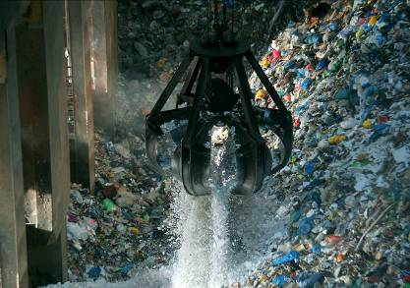
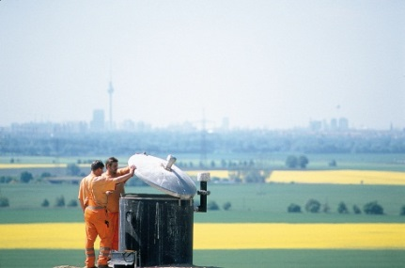
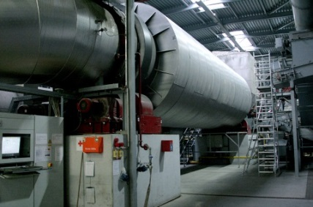
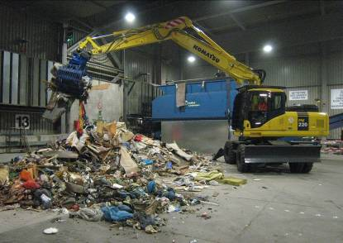
A big city can be supplied with electricity and heat from the energy in Berlin's waste (Status 04.2021)
incineration plant Ruhleben
3 landfill sites
with CHP
2 mechan.-physic. stabilization system plants
processing of waste wood and bulky waste
fermentation plant for organic waste
steam
approx. 1.5 Mio. Mg/a
gas from landfill sites:
approx. 22 Mio. m³/a
substitute solid fuel:
approx. 187,000 Mg/a
substitute solid fuel:
approx. 60,000 Mg/a
biomethane: approx. 31,800 MWh/a
approx. 210 GWh electricity
approx. 740 GWh
district heating
approx. 42 GWh electricity, approx. 21 GWh district heating
approx. 194 GWh electricity
approx. 70 GWh electricity
approx. 25,700 MWh for substitution of von Diesel fuel; approx. 2,200 MWh for generation of electricity and heat CHP
Covers need for electricity of approx. 12 % of average households of Berlin and the need for district heating of approx. 7.4% of households of Berlin with a district heating connection
15

